Slide 1
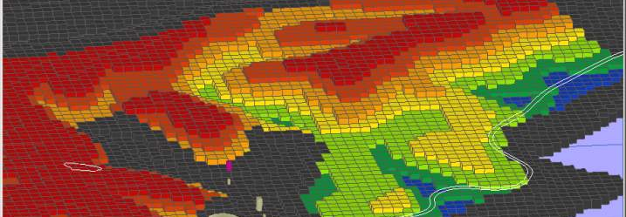
Chemistry impact on Raw Material Extraction
Technical Development Program for PPE, 2015-2016

Slide 2
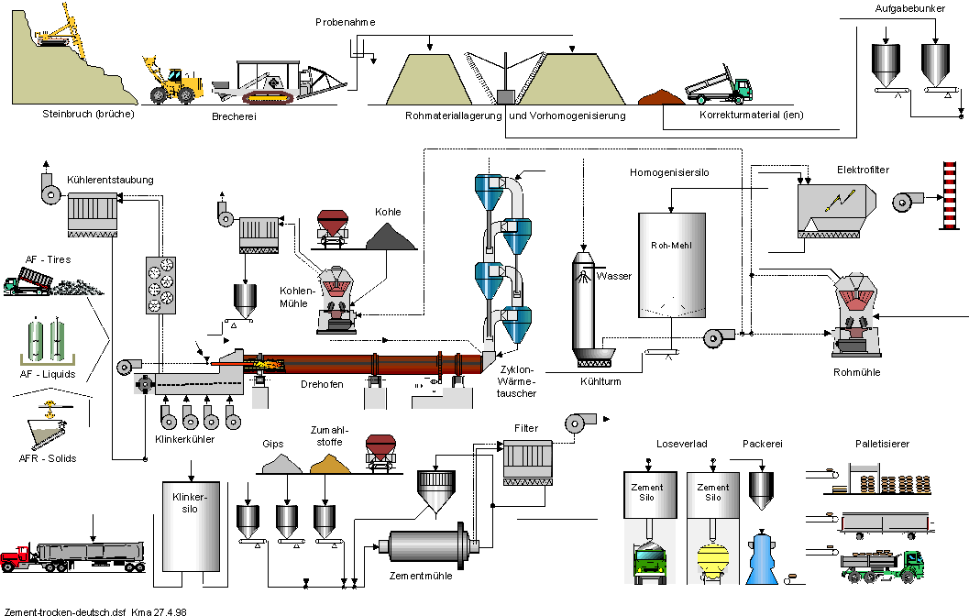
MMT – RMPH Areas of Activities
Geological Investigation
Reserves, Mining, Preparation & Handling

Slide 3
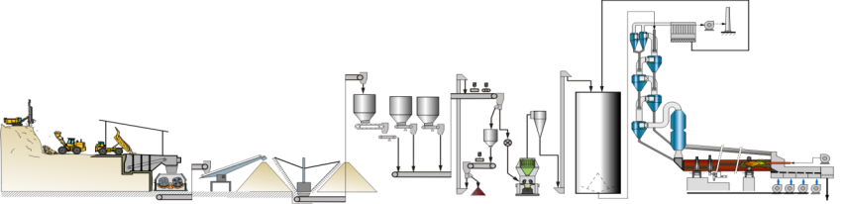
Process Overview
Material chemical homogeneity
Material size reduction
Material moisture reduction
Material handling

Slide 4
Size Reduction
Blasting
Crushing
Grinding
Dosing for optimal size reduction process

Slide 5
Moisture Reduction
Selective mining
Material dewatering / precipitation protection
Drying

Slide 6
Sensitivity Analysis
The quarry is supposed to deliver raw materials according to the production needs of the plants
These needs are typically defined in terms of LS, SR, AR, minor constituents like MgO, SO3, TOC etc.
The QSO “Optimizer” tool calculates the maximum achievable raw mix tonnage from a deposit, based on these requirements
The QSO “Batch Optimizer” does the same thing, but it allows to vary one (or two) of the parameters
With this it can be seen which of the quality parameters are more or less critical in terms of possible changes due to production changes, product changes, corrective or AFR changes etc., and in which way they are critical

Slide 7
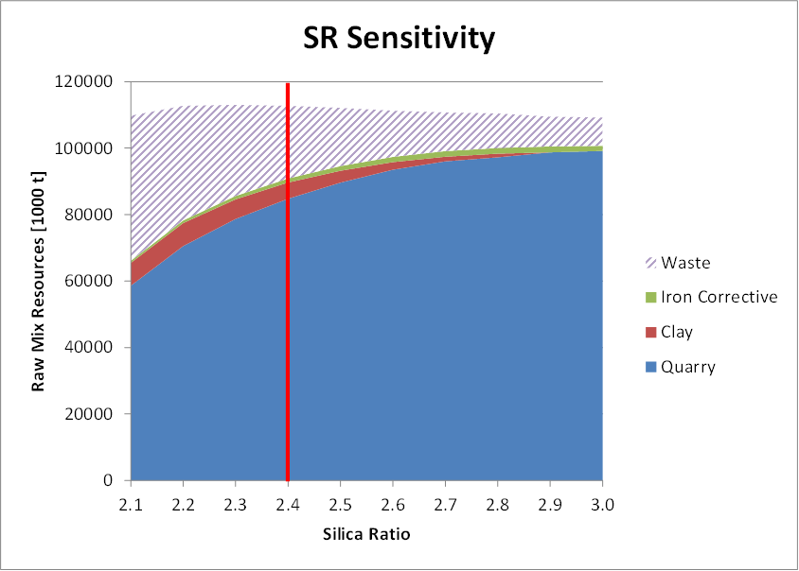
Clear trend: SR Ibity
This example shows a clear trend: the higher the target SR, the higher the tonnage and the lower the waste ratio
Red line: currently defined target quality

Slide 8
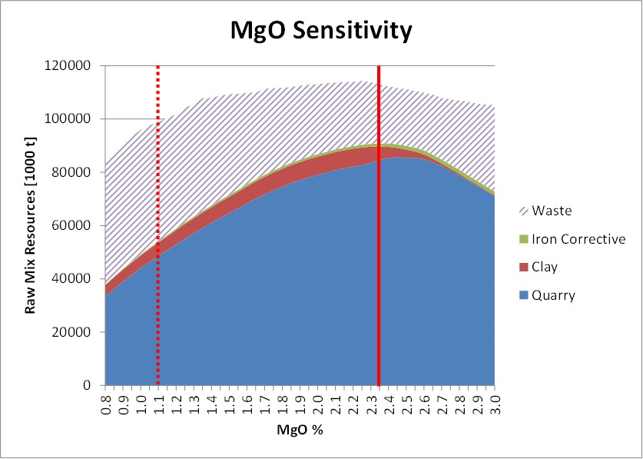
Tonnage maximum: MgO Ibity
Total achievable tonnage and lowest waste ratio from the Ibity quarry is highest with an average MgO around 2.3-2.4%
In order to realize such a MgO target, blasthole sampling and the use of QuarryMaster is required

Slide 9
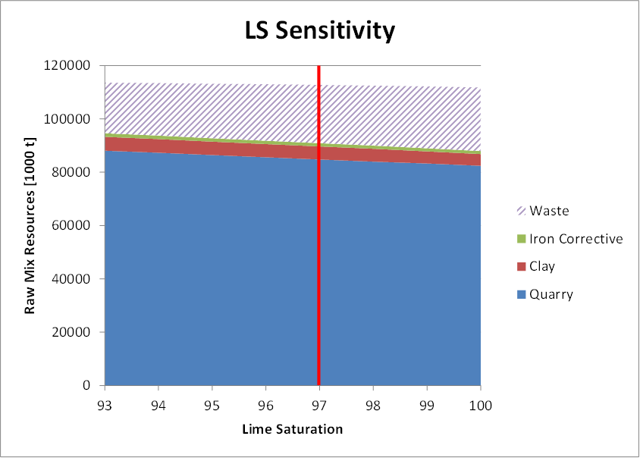
LS sensitivity
Minor sensitivity effect: LS Ibity
Very important sensitivity: LS Maratha

Slide 10
Message
For every change in raw material quality requirements consider the consequences for the quarry

Slide 11
Message – Consequences of Quality Changes for the Quarry
Any major change in raw material quality requirements needs to be cross-checked with the Raw Material Management tools, to see the consequences for quarry lifetime, wasting etc.
Having a sensitivity analysis allows to estimate already in advance
An indirect consequence is the need for recalculating long/medium term schedule quarry schedules
And this in turn may require also an update for the mines planning and equipment optimization
Only based on this, the daily quarry operation can continue to work according to a long term view
Short notice quality changes that are ordered from the quarry require a switch to “ad hoc” operation, ignoring any planning
Such a “strategy” will most likely spoil the quarries long term potential

Slide 12

Operation of Preblending Systems
Technical Development Program for PPE, 2015-2016

Slide 13
Homogenisation Overview
Kiln dust management
Quarry operation
Preblending
Raw mill
Crushing
Mix proportioning
Homogenising
Long term
Short term
13

Slide 14
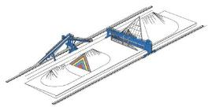
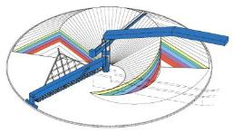
Preblending System Design
Raw meal uniformity (s_{LSF} after raw mill)
Target short term (hourly samples over 24h): < 3.6
Target long term (daily values over 1 month): < 1.0
Storage capacity sufficient for weekend operation
Parameters that influence blending efficiency
Pile formation
Chevron / chevcon / windrow stacking
Front reclaiming
Number of layers > 250
Pile geometry
LPS: Length / width ratio: > 4:1
CPS: Stacking angle: 110-120°
14

Slide 15
Blending Efficiency
e Blending efficiency
n Number of layers
A Pile cross-section
v Stacker travelling speed
q Stacking capacity
Always complete piles
Increasing stacker speed gives more layers (up to max. 35 m/min, consider the mechanical condition of the stacker
Crusher capacity and preblending bed size have to match
(for statistically independent layers)
with
15

Slide 16
Operation of Preblending Systems
The End Cone Effect
16

Slide 17
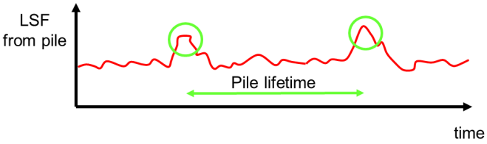
Impact on Performance
Problem
Peak disturbance when cutting a new pile
Correcting by means of additive proportioning is possible but expensive symptom fighting
Solution
Improved layering solves the problem at its source
17

Slide 18
Problem: End Cone Effect
Layering pattern
In the beginning only very few layers are reclaimed at a time
Segregation
Coarse particles (often having a different chemical composition) tend to roll down the pile
These particles are reclaimed first
18

Slide 19
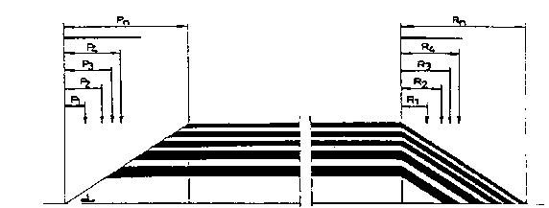
Solution: Variable Stacker Reversing Points
Instead of stacking all layers up to a single reversing point, make reversing points dependant of the stacking height. This
reduces segregation
allows to reclaim all layers from the beginning
reclaiming
Inner pile end
Outer pile end
19

Slide 20
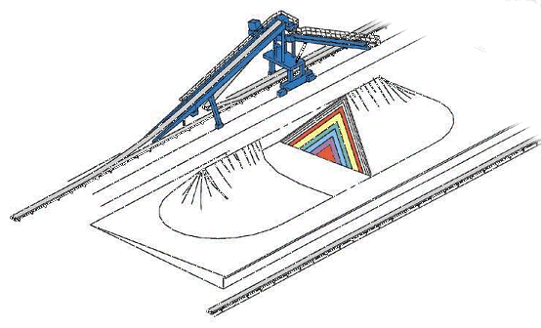
Requirements
Sensors and encoders
To determine angles, travel distances, speeds and stacker positions
Actuators
For stacker operation
S
A
A
S
S
Sensor
Actuator
A
20

Slide 21
Reference Points
A number of reference points need to be fixed to the rails
Marks for pile boundaries (as safety switches)
Marks for the centre position between both piles
Reference distance to correct encoder results for wheel slippage
21

Slide 22
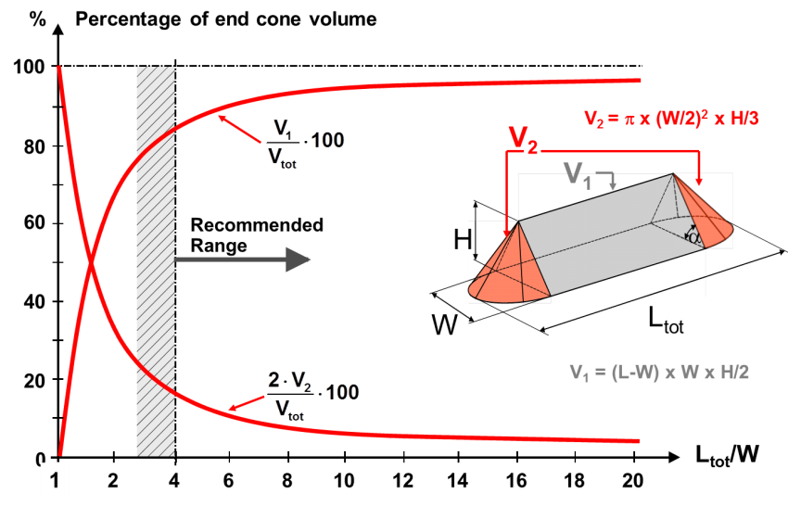
Pile Geometry
22

Slide 23
Uniformity Improvement
Preblending system
Reduced compositional peak disturbances when starting to reclaim from a new pile
Homogenising silo
Reduced disturbances going into the silo
Which can be handled better by the silo
LSF
LSF
fixed reversing points
variable reversing points
t
t
23

Slide 24
Operation of Preblending Systems
Addition of Minor Components
24

Slide 25
Raw Mix Adjustment
Raw mix adjustment by addition of minor components can be done in two ways
By addition to the preblending system at the crusher
Via feed bins to the raw mill feed
25

Slide 26
Addition of Minor Components – Problematic Concepts
The following concepts are not recommended
Truck wise addition to the crusher → Leading to a patchwork distribution of the minor component
Single layer addition to the crusher → Distribution depends on stacker position and is not consistent
L
L
26

Slide 27
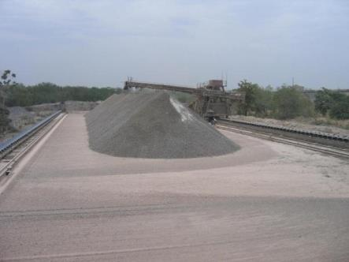
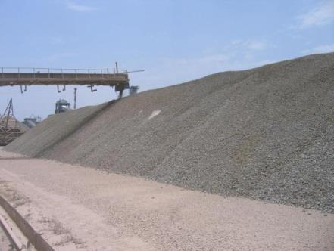
Addition of Minor Components – Problematic Concepts
Patchwork type addition of minor components
27

Slide 28
Addition of Minor Components – Recommended Concepts
The following concepts are recommended
Double layer addition to the crusher (forth and back movement of the stacker) → Only for longitudinal preblending systems
Addition at controlled rate to the crusher via additional feed hopper
J
J
J
J
28

Slide 29
Addition of Minor Components – Recommended Concepts
Addition to the raw mill by means of a bin & feeder
Selection of small feed bins
Do not abuse feed bins as storage
Do not control feed rates directly out of large storage silos
Never feed several mills out of a common feed bin
Always design feed bins for mass flow (according to material characteristics)
Calibrate feeders regularly and keep them clean
29

Slide 30
Operation of Preblending Systems
Material Activation
30

Slide 31
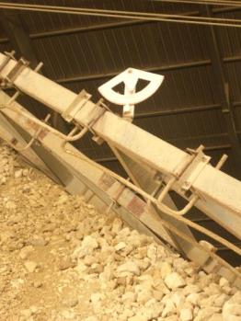
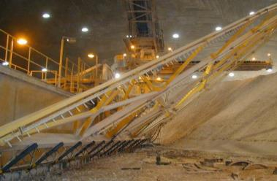

Pile Face Activation
Insufficient material activation
Difficult to handle material will not roll down the pile face
Formation of deep channels
Material is finally activated by rake structure → wear
Improved material activation
Use bows instead of pins on the rake
Always adapt rake inclination to angle of repose
31

Slide 32
Operation of Preblending Systems
Chain Life
32

Slide 33
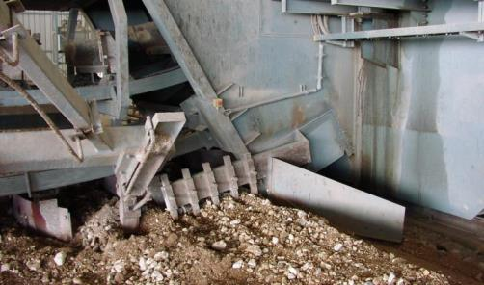
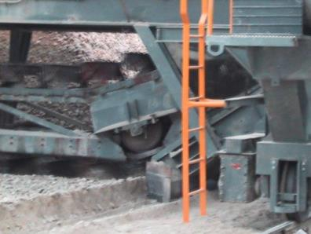

Impacts on Chain Life
Design of the transition to the delivery chute
Prefer a guided rail design over a sprocket wheel to prevent polygon effect
33

Slide 34

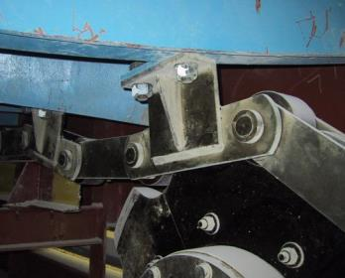
Impacts on Chain Life
The traction function of the chain should be independent of guidance function in order to lower wear on rollers & guides
Install rollers directly on the scraper supports rather than on the chain
34

Slide 35
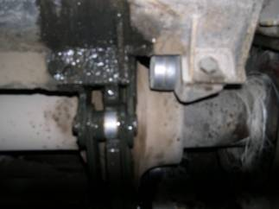
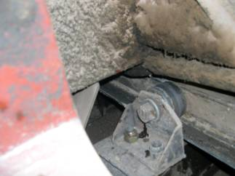
Impacts on Chain Life
Tension on both chain strands should be even
Do not over lubricate chains (to prevent material build-ups)
Reduce uneven wear on scrapers
Prevent material from falling on wheels (install covers)
35

Slide 36
Operation of Preblending Systems
Floor Grading
36

Slide 37
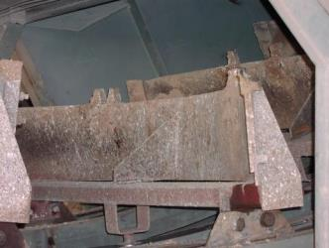
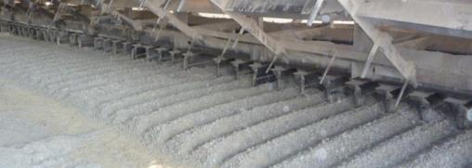
Floor Grading
Prevent floor compaction in order to
Prevent reclaimer chain damage when switching pile
Reduce power consumption and wear of scrapers
Install loosening teeth on scrapers
Staggered pattern
Grade the floor once a year
Run the chain also when shunting
37

